Slide 1

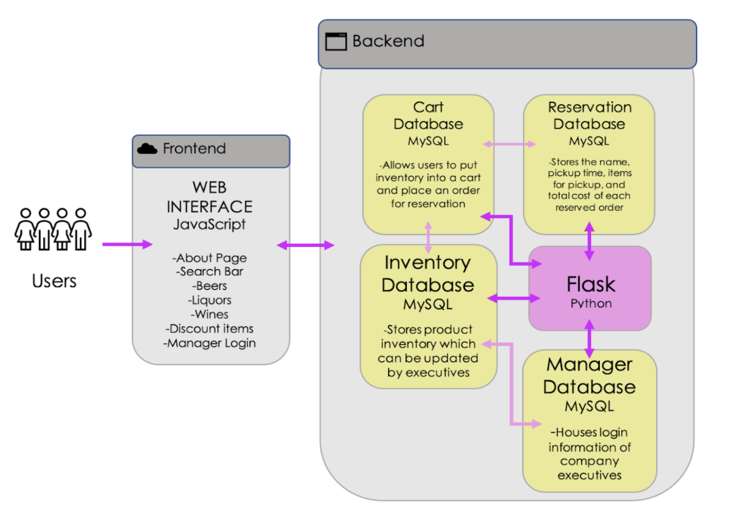
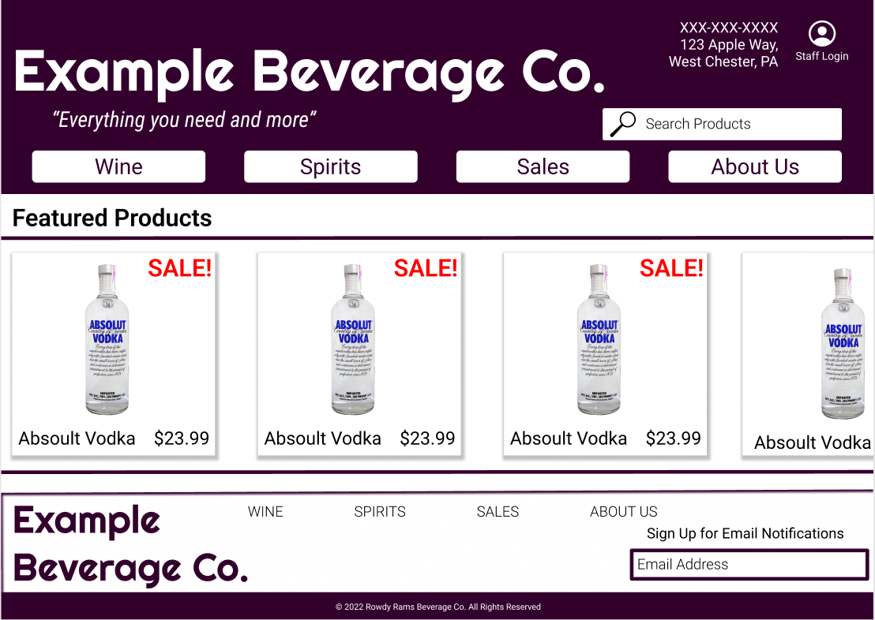
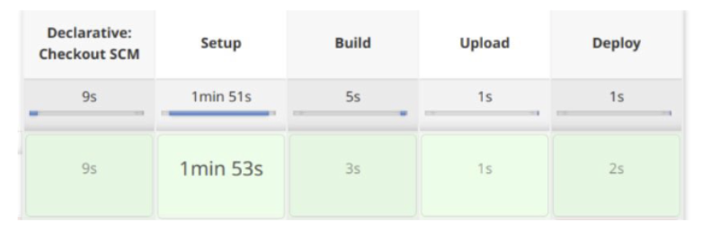
Rowdy Rams Beverage Co.
By: Emily Miller, Cade Uhlin, Mike Hutelmyer, Bella Bedore, and Tyler Pittenger
https://github.com/CadeUhlin/moola-miners.git
Team Vision
Rowdy Rams Beverage Co. is an end-to-end solution to enhance inventory tracking technology for alcohol retail establishments. This website will allow customers to reserve an order for later pickup and purchase onsite. This will ensure that the distribution center will have enough inventory available to provide customers with their order, at the time of pickup. While designing the system architecture of this project, convenience and scalability are large components in the implementation of databases.
Design
Front-end Components:
We are creating a single website using React. This webUI allows the using to search the inventory and create a cart to items to place on hold and be picked up.
Back-end Components:
For our back-end, we are using Python and Flask to handle url endpoints and communications with the database.
Database:
We are using mySQL to create our database which will act as the store’s inventory.
Technical Diagram
CI/CD Application
Leveraging Jenkins, an open-source automation server, Rowdy Rams Beverage Co.’s servers will be able to update and upgrade existing technologies without any downtime.
Kube Controller
Overlay Network
Kubelet
kubernets-apiserver
Pod: Jenkins
Container: jenkins
8080
50000
Pod: rowdy_rams
Container: inventory_data
Container: employee_data

